Slide 1
General announcements

Slide 2
Work Lab
Things that will make this lab way easier:
Please read carefully and don’t skip steps!
Record data carefully for each question, and keep track of units, signs, and what you’ve recorded. Practice blurbing!
Every time you move or rotate the force transducer, you need to re-zero it (not recalibrate, just zero it out)
In your write-up, remember to record all data at the beginning, with labels and blurbs as to what each number represents.
When doing the calculations and analysis, BLURB!
For each question, start with a brief statement of what you’re doing in that part.
Any time you make an assumption, substitute in values, make a logical jump that isn’t just a clear algebraic step, write a brief blurb to explain it!
Remember that an outsider should be able to read an understand your write-up WITHOUT looking at the lab handout.

Slide 3
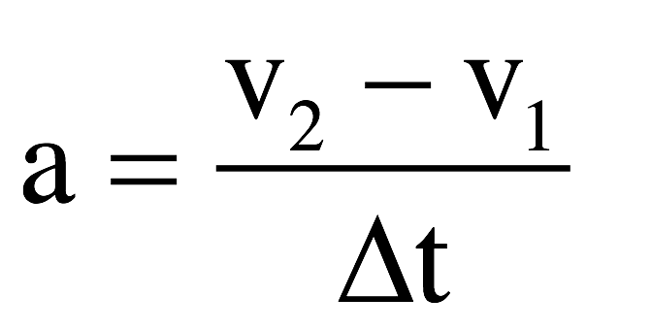
Back to our realm of work and energy…
So we know that $W= \vec{F}∙\vec{d}=Fdcosθ$, and work causes a change in energy.
+ work adds energy, - work removes energy
Let’s assume that 𝝷 = 0, so W = Fd. We can restate this as:
Assuming the net force is constant, the acceleration will be constant. This means we can use kinematics:
So we can re-write net work as…
$$W=\left(ma\right)d$$
and

